Slide 1

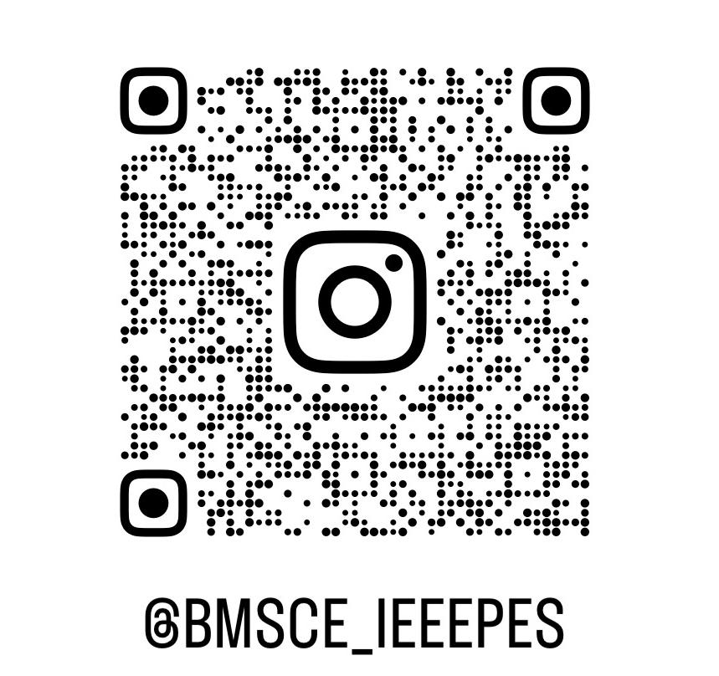

Slide 2

SCAM
Notes:
Opening joke: the slide just says SCAM, like a rubber stamp. Let it sit for a second before you speak. Suggested line (the fake-SMS bit): “Dear student, your ESP32 has been SUSPENDED due to incomplete KYC. To resume, reply with your OTP.” Pause. “Relax. Nobody’s stealing your OTP. The only thing I’m stealing today is 6 hours of your life, and I promise you’ll want to give them.” Bridge to your intro: “Funny thing: I’ve actually worked on fighting real scams like this, at the Department of Telecom…” → next slide. Callback for later: suspend and resume are real FreeRTOS words (vTaskSuspend, vTaskResume). On the task-states slide: “Remember the scam? Your task just got suspended. Here’s how you resume it.”

Slide 3
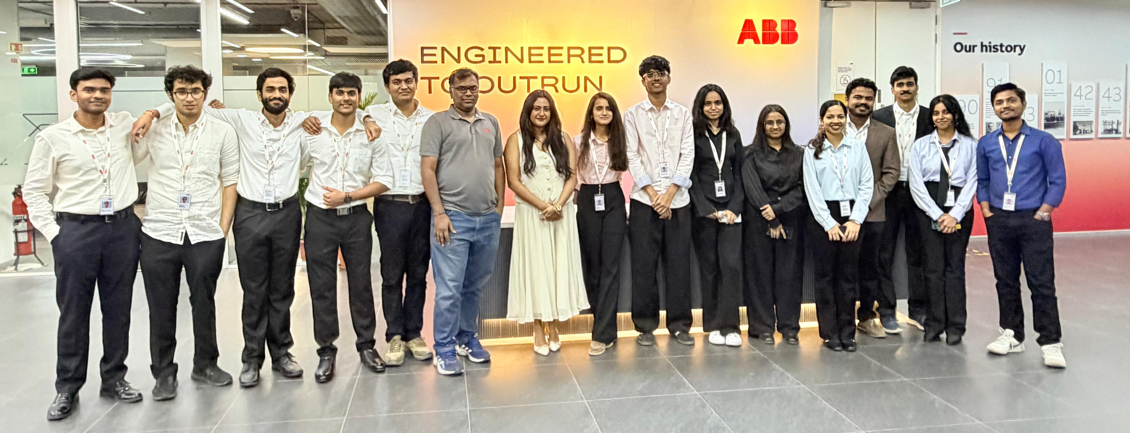
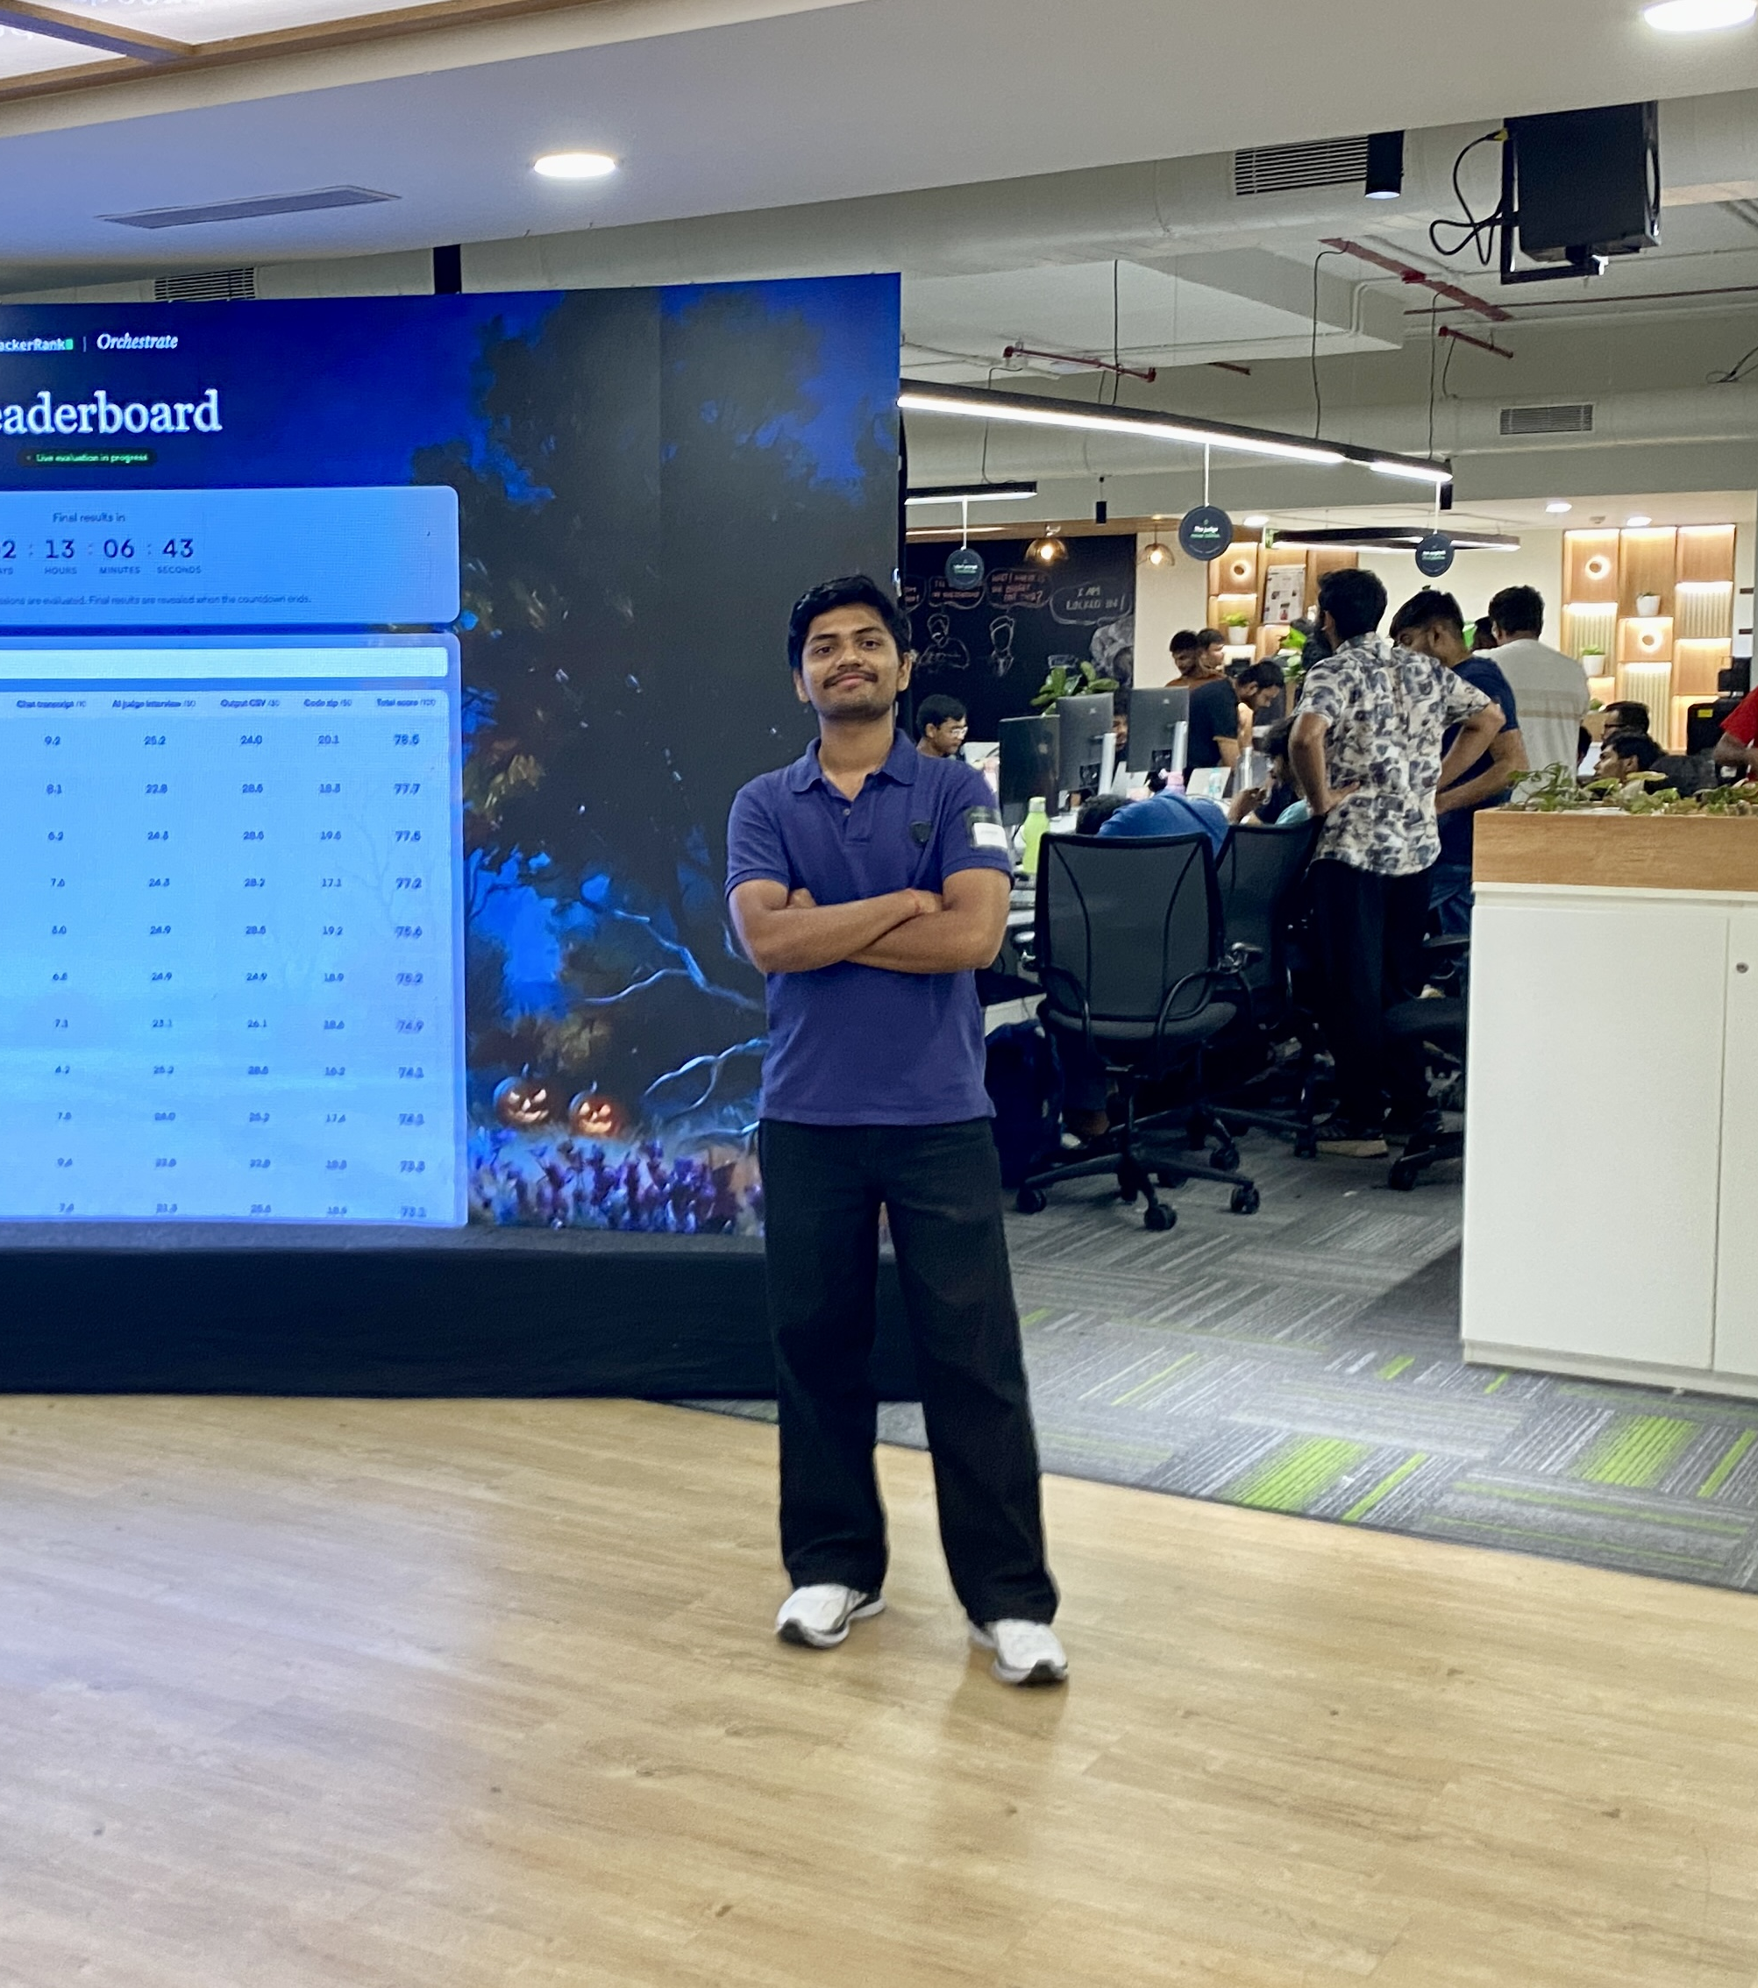


The Manish starter pack
ECE @ BMSCE · embedded × AI · professional hackathon survivor
UN Youth Envoy. 1 of 3 from India
AI engineering @ ABB
WINNER
Claude Hackathon Bengaluru ’26
helped India block stolen phones (Sanchar Saathi)
#215 / 4,000+
the guy who’ll make you love RTOS
1 of 100
HackerRank Orchestra
at IISc’s summer school
Notes:
The “starter pack” meme: everything that makes up Manish. Walk around the stickers, one line each, about 60 seconds. ABB: AI engineering, building AI agents on Abby for ABB’s analytics workflows, with teams in India and Sweden. (If asked: it was an internship.) UN: one of three ITU Generation Connect Youth Envoys from India (2026–2030), selected via the Department of Telecommunications. DoT: Sanchar Mitra. Hook: “Ever blocked a stolen phone on Sanchar Saathi? I worked on that reporting flow.” Claude Hackathon Bengaluru 2026: won with an agent that turned weeks of engineering-drawing work into seconds. HackerRank Orchestra: ranked 215 of 4,000+. IISc EE Summer School: 1 of 100 selected from across India. Photo caption: “the guy who’ll make you love RTOS.” Call back to it at the end of Day 2. Add your photo in the polaroid and the three logos in the white stickers.

Slide 4
THE PLAN
01
RTOS knowledge
2 days.
not just the definition
02
A real hardware project
real hardware, on your desk
here’s what you walk out with →
03
Numericals and exam ready
straight from your EC syllabus
04
AI Fluency
like an engineer, not a copy-paster
05
New friends & Have fun.
and a ridiculous amount of fun
Coding is dead. Engineering is the biggest opportunity.
Notes:
Big, confident, casual. In Present mode the five lines rise in one at a time, then the closing line fades in. Click through them as you talk. 01 RTOS, for real: by tomorrow evening you can explain what an RTOS is, why it exists, and how it decides which task runs (Day 1), plus how tasks talk and share safely with queues, mutexes and semaphores (Day 2). 02 A project that works: a real ESP32 project running FreeRTOS, wired today and finished tomorrow. 03 Numericals, sorted: the scheduling problems from your EC syllabus (FCFS, SJF, round-robin, RMS), on Day 2. 04 AI, used right: how to use AI like an engineer to learn and build faster. 05 New friends: teams, challenges, a leaderboard. Closing line: “Coding is dead. Engineering is the real flex.” Then the serious version: in the age of AI, writing code is getting cheap; understanding systems is the biggest opportunity of all time, and this workshop is your gateway.

Slide 5
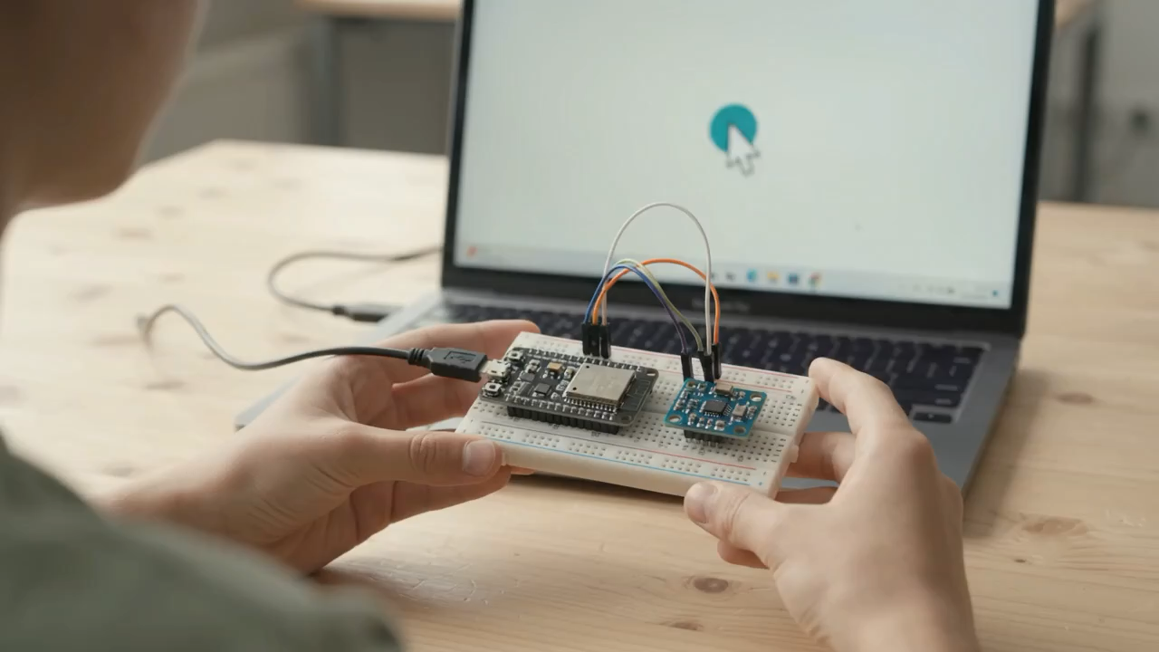
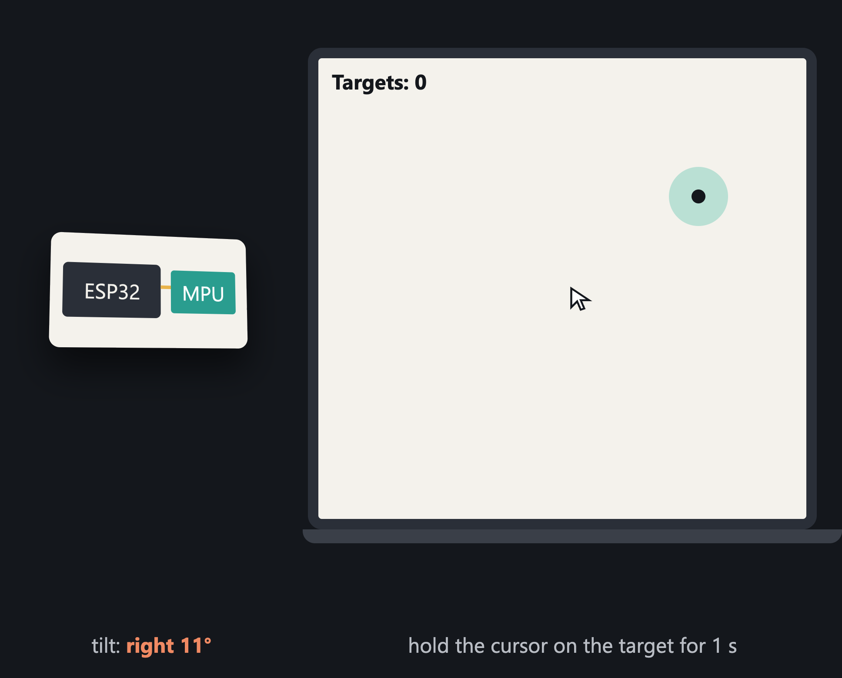
By 5 PM tomorrow, you build this.
THE OUTPUT · TILT MOUSE
Tilt to move
More tilt, faster cursor
Hold flat to stop
A ±5° dead zone gives accuracy
Hover 1 s to hit
Fastest team wins
Notes:
LIVE DEMO (or let the animation play). The project: a Tilt Mouse. Only an ESP32 and an MPU-6050 on a breadboard, plugged into a laptop by USB. A web page in Chrome shows a cursor and targets. Tilt the breadboard and the cursor slides that way; tilt more and it moves faster. Hold it flat and the cursor stops, thanks to a small dead zone. Hold the cursor on a target for 1 second to hit it; the page times each team. Real-world link: air mice for smart TVs and presentations, game controllers, and tilt control in phones all use the same idea. Line: “By 5 PM tomorrow, every bench builds this, and you’ll understand exactly why it feels smooth, and what makes it feel laggy.”

Slide 6
Real-Time Operating Systems
WORKSHOP · DAY 1 OF 2
Building deterministic embedded systems on the ESP32 with FreeRTOS
alarm_task
imu_task
servo_task
status_task
Notes:
Title slide. Keep it on screen while students settle in. The coloured bars at the bottom are a real scheduler trace: four tasks sharing one CPU. By the end of today they will be able to read it.

Slide 7


A Real-Time Operating System is a tiny OS that guarantees the most urgent job runs on time, every time.
WHAT IS AN RTOS?
read the sensor
every 10 ms
THE RTOS SCHEDULER
move the cursor
“Who is most urgent right now?”
CPU
every 20 ms
runs it, on time
blink the LED
whenever there’s time
Real-time
Operating system
Tiny
= on time, every time. Not “fast”.
= shares one CPU between many jobs
= a few KB, built into your firmware
Notes:
Read the definition once, slowly. Then make them understand it by breaking it into three words (bottom row). REAL-TIME means predictable, not fast. The question is never “how fast on average?” but “can you guarantee it’s never late?” A late answer is a wrong answer. OPERATING SYSTEM: one CPU can only do one thing at a time, but a device has many jobs. The OS decides who gets the CPU. TINY: FreeRTOS is a few C files compiled into your firmware. No desktop, no apps, no booting into Windows. Walk the diagram left to right using tomorrow’s project: reading the sensor every 10 ms, moving the cursor every 20 ms, blinking an LED whenever there’s time. The RTOS scheduler keeps asking one question, “who is most urgent right now?”, and gives the CPU to that job, so the urgent ones are never late. Analogy for your delivery: a traffic cop at a busy junction. Every car wants to go; the ambulance always goes first, and the cop guarantees it never waits more than a few seconds. Check question for the room: “Is an RTOS faster than Windows?” Answer: not necessarily. It’s more predictable.

Slide 8
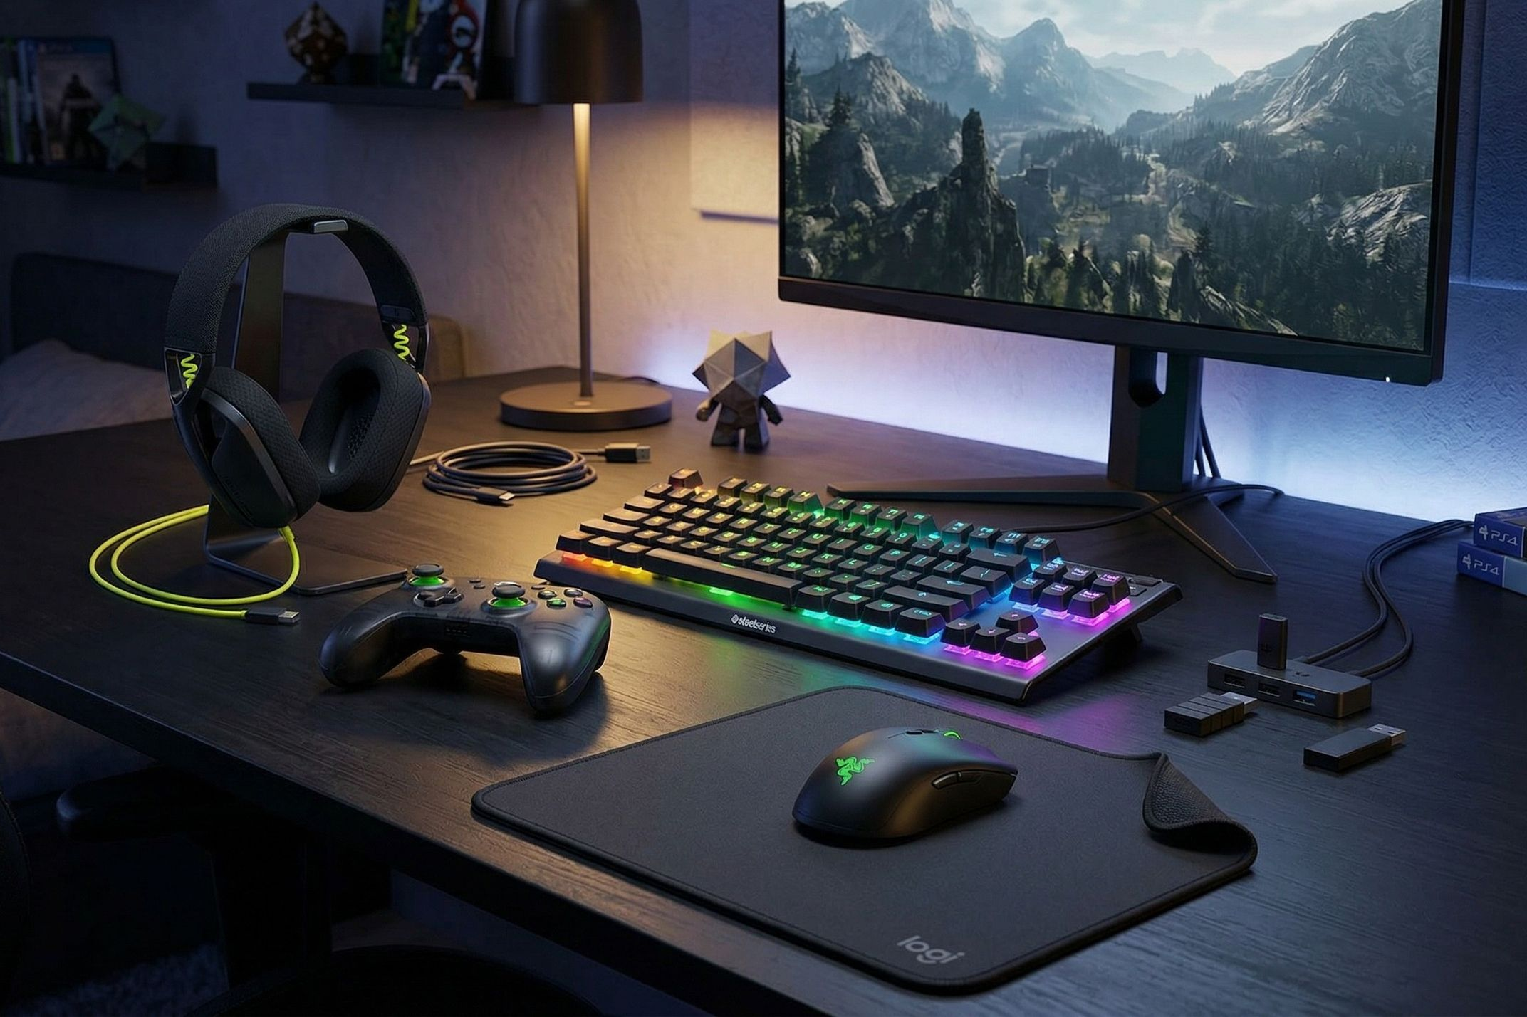
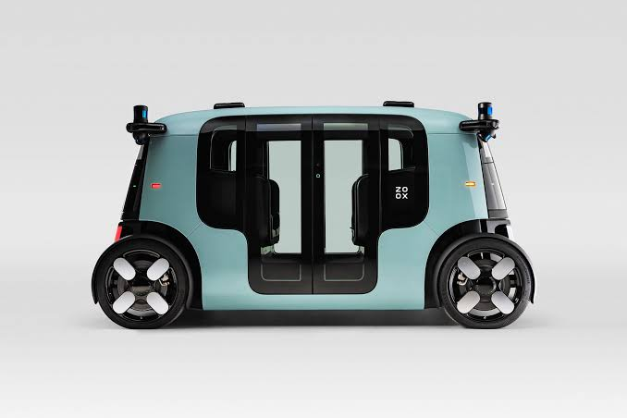


Real-time is everywhere
EXAMPLES
Gaming mouse
Self-driving car
Pacemaker
Starship
Read the sensor and report your hand’s movement
See a pedestrian, decide, and hit the brakes
Sense a missed heartbeat and send a pulse
Steer 33 engines and the fins, mid-flight
every 1 ms, or your aim lags
in a fraction of a second
every beat, for years
many times every second
Miss the deadline → a laggy aim, a crash, a skipped heartbeat, a lost rocket.
Notes:
Four examples, from your desk to space. Each has a job and a deadline. Go left to right, the stakes keep rising. Gaming mouse: good gaming mice report movement 1000 times a second (1000 Hz polling). Late reports feel like lag. This is also tomorrow’s project: we build a mouse. Self-driving car: the system sees an obstacle, decides, and brakes. A correct decision that arrives late is useless. Pacemaker: senses the heart’s rhythm and delivers a pulse exactly when a beat is missed, reliably for years on a tiny battery. A classic hard real-time system. Starship: SpaceX’s Super Heavy booster has 33 Raptor engines. The flight software continuously steers the engines and fins to keep the rocket on course. Late corrections mean a lost vehicle. Point to make: the job is different in each, but the requirement is the same: the right answer, on time, every time. Careful with claims: these are real-time systems. Not every one of them runs an off-the-shelf RTOS (for example, SpaceX is known to use Linux-based flight computers), but every one of them is built around guaranteed timing. Add four photos in the frames.

Slide 9
Let’s just put everything in loop()
BUILDING OUR MOUSE · VERSION 1
void loop() {
blinkLED(); // takes 1 s
readSensor();
moveCursor();
}
WHAT THE CPU DOES IN ONE LOOP
you tilt the board here
blinking the LED (busy for 1 second)
read sensor · move cursor
looks innocent, right?
the cursor moves almost 1 second late
IN ONE LINE
In one big loop, every job waits for every other job. The cursor lags because the CPU is stuck blinking an LED.
Notes:
STORY: “We’re building a mouse. The board has to read the tilt sensor, move the cursor, and blink a status LED. Version 1: the way we’ve always written Arduino code. Put everything in loop().” Point at the code. Ask: “Anything wrong?” Most will say no. LIVE DEMO (Demo1_SuperLoop): flash this version (blinkLED uses delay(500) twice); the Serial Monitor draws the tilt as a bar that only updates once a second. A volunteer tilts the board right after the LED turns on. The cursor/LED reacts almost a second later. Repeat 2–3 times. Explain the timeline in plain words: the CPU is one worker that can only do one thing at a time. In this loop, it spends 1 whole second blinking the LED (most of it just waiting inside delay()). Reading the sensor only happens after that. So if you tilt at the start, the cursor reacts about a second later. Why it gets worse: every new feature you add makes the loop longer and every other job slower. One stuck function (a sensor that doesn’t answer) freezes everything. And nothing can be “more important” than anything else. Student question you’ll get: “Use millis() instead of delay()?” Yes, that helps for small programs, but the code becomes a tangle of timers, and one slow function still blocks the rest. Real products need a better way. Next slide.

Slide 10

Two better ideas
BUILDING OUR MOUSE · VERSIONS 2 & 3
V2 · Interrupts
half fixed
V3 · An RTOS
fixed!
sensor: “new data!”
CPU pauses, runs a tiny ISR
back to loop
read sensor
move cursor
blink LED
↓ the scheduler picks who runs ↓
The hardware taps the CPU on the shoulder the moment something happens.
Each job becomes its own little program, called a task.
Good: the urgent task runs first. A task that’s waiting uses zero CPU.
Good: instant reaction. But: the ISR must be tiny, and everything else is still one tangled loop.
IN ONE LINE
An RTOS splits your program into tasks, and a scheduler always runs the most urgent one.
Notes:
STORY continues: “Version 1 lagged. How do we fix it? Two ideas.” VERSION 2, INTERRUPTS. Most chips can be “interrupted”: when something happens in hardware (new sensor data, a button press, a timer), the CPU immediately pauses what it’s doing, runs a short function called an ISR (Interrupt Service Routine), and then returns to where it was. Think of it as a tap on the shoulder. Great for reacting instantly. Two problems: (1) the ISR must be tiny, because while it runs everything else waits; (2) all the normal work is still one tangled loop, with no priorities. VERSION 3, AN RTOS. Write each job as its own small program with its own loop: a read-sensor task, a move-cursor task, a blink-LED task. A piece of software called the scheduler decides which task gets the CPU, many times a second. The most urgent ready task always wins, even if it has to pause a less important one in the middle (that’s called preemption). When a task is waiting (for its next turn, or for data), it’s put aside and uses no CPU at all, unlike delay() in Version 1. Be honest about the price: each task needs its own bit of memory, switching costs a few microseconds, and new bugs appear when tasks share things. That’s Day 2. Note: interrupts don’t disappear in an RTOS. They work together with tasks (Day 2).

Slide 11
What happens if it’s late?
HARD · FIRM · SOFT REAL-TIME
job starts
DEADLINE
result arrives late…
HARD
FIRM
SOFT
Airbag
Video call
Spotify
Late = someone gets hurt
Late frame = useless, skipped
Late = just annoying
must never be late
a rare miss is OK
still works, just worse (like our mouse)
IN ONE LINE
Hard: never late. Firm: late is useless. Soft: late is annoying.
Notes:
STORY: “Our mouse was a second late in Version 1. Is that a disaster? It depends on the product. Every job has a deadline: the latest moment its result is still useful.” Walk the timeline: the job starts, there’s a deadline, and the result arrives AFTER it. What happens now? Three possible answers, three types of real-time system. HARD (airbag, pacemaker, brakes): a late result causes harm. The airbag that fires after your head hits the steering wheel is worse than useless. These systems must never, ever miss a deadline. FIRM (live video call): a late result is useless and simply thrown away. A video frame that arrives after the next one is skipped; nobody gets hurt, and a rare miss is acceptable. SOFT (Spotify, games, our mouse): a late result is still used, just at lower quality. The song buffers for a second, the cursor lags a little. Annoying, not dangerous. GAME (optional, 2 minutes): read out systems and let teams shout Hard / Firm / Soft: pacemaker (hard), phone scrolling (soft), radar sample (firm), ABS brakes (hard), YouTube (soft). Exam definitions: hard real-time = every deadline must be met; firm = late results are worthless but not harmful; soft = occasional misses are tolerated with reduced quality. Throw back: “Our mouse is soft. So why build it with an RTOS?” Because the same skills build the hard ones, and nobody likes a laggy mouse.

Slide 12
My laptop is super fast. Why not use that?
FAST ≠ REAL-TIME
POV:
20 ms ping the whole match… 900 ms in the final clutch.
Laptop (Windows, Linux, macOS)
RTOS
never past this line
time to respond →
time to respond →
Usually instant. Sometimes, randomly, very late (red).
Maybe a bit slower. But never late.
Real-time doesn’t mean fast. It means predictable: the worst case is known and guaranteed. That’s called determinism.
IN ONE LINE
Notes:
STORY: “A student always asks: my laptop has a 5 GHz processor. Why not just use that instead of a tiny ESP32?” Start with the POV sticker. Every gamer knows it: you don’t lose to your average ping, you lose to the one spike at the worst moment. How to read the charts (illustrative, not measured): each bar shows how often the system takes a certain time to respond. Further right = slower. LEFT, a laptop OS: almost always instant, but sometimes something else grabs the CPU (an update, another app, memory being moved) and the response is suddenly very late. There’s no limit on how late (red bars). RIGHT, an RTOS: maybe a little slower on average, but it never crosses a known line. That line is the promise. The word to remember: DETERMINISM, meaning you can predict, and guarantee, the worst case. Example to make it stick: a 5 GHz gaming laptop cannot promise to respond within 1 ms every single time. A 240 MHz ESP32 running an RTOS can. Check question: “Is an RTOS faster than Windows?” Not necessarily. It’s more predictable.

Slide 13
What’s inside any operating system?
OS BASICS
Your apps
Chrome, Spotify, your Arduino code…
why the wall?
↓ apps ask the kernel for help ↓
So one crashing app can’t take down your whole laptop.
The kernel · the boss of the hardware
decides who runs
manages memory
talks to devices
but on an ESP32…
passes messages
FreeRTOS has no wall. One buggy task can crash the whole board.
Hardware · CPU, memory, sensors
IN ONE LINE
The kernel is the boss of the hardware. Apps have to ask it for everything.
Notes:
STORY: “So an RTOS is a kind of operating system. What does any operating system actually contain?” Walk the layers, top to bottom: APPS are the programs you use (Chrome, Spotify, your Arduino code). They’re not allowed to touch the hardware directly; they ask the kernel for help. Those requests are called system calls. The KERNEL is the core of the OS, the boss of the hardware. It decides which program runs on the CPU (scheduling), manages memory, talks to devices like the screen and sensors, and passes messages between programs. HARDWARE is the physical stuff underneath. Why the wall between apps and kernel? So one crashing app can’t take down the whole computer. Exam words: user space (apps) and kernel space (kernel). Reality check: on a microcontroller, FreeRTOS usually has no such wall. Everything shares one memory, so one buggy task can crash the whole board. You’ll see it live in Block C. Next slide: there are two ways to build a kernel, and the difference shows up when something crashes.

Slide 14
A driver crashes. What happens?
MONOLITHIC VS MICROKERNEL
Monolithic · Linux
Microkernel · QNX (cars)
files
driver ✗ restarting…
Wi-Fi
ONE BIG KERNEL
scheduler
memory
files
driver ✗ crashed
Wi-Fi
↕ talk by sending messages ↕
EVERYTHING DOWN
TINY KERNEL
scheduler + messages
fast… but one bug takes everyone with it
everything else keeps running
safer… a little slower
IN ONE LINE
Monolithic: one big box, fast but fragile. Microkernel: tiny core + separate parts, safer.
Notes:
STORY: “There are two ways to build a kernel. The easiest way to see the difference: break something. A driver crashes. What happens?” LEFT, MONOLITHIC (Linux): everything lives inside one big kernel: scheduler, memory, files, drivers, Wi-Fi. They all call each other directly, which makes it fast. But they share everything, so when one driver crashes, it can bring the whole kernel down with it. Everything stops. RIGHT, MICROKERNEL (QNX, used in many car dashboards and infotainment systems): the kernel is tiny, only the essentials (scheduling and passing messages). Files, drivers and Wi-Fi run outside as separate programs that talk to each other by sending messages. When the driver crashes, only that one part goes down, and it can simply restart. Everything else keeps running. The price: sending messages is slower than calling a function directly. Analogy if helpful: a joint family under one roof (one fight affects everyone) vs separate flats in one building. Where does FreeRTOS fit? It’s even smaller than a microkernel: basically a scheduler plus communication tools, compiled into your firmware. No separate services at all. Next slide: the comparison table for the exam.

Slide 15
Normal OS vs RTOS · two kinds of kernel
SIDE BY SIDE · EXAM CHEAT SHEET
GPOS vs RTOS
Monolithic vs microkernel
 | Normal OS | RTOS
Goal | fair to every app | urgent job first
Timing | fast on average | guaranteed worst case
Who runs | everyone gets a share | highest priority
Size | MBs to GBs | a few KB
Runs on | laptops, phones | microcontrollers
Examples | Windows, Linux | FreeRTOS, QNX
 | Monolithic | Microkernel
Inside kernel | everything | only essentials
Speed | faster | a bit slower
A driver crashes | whole OS can crash | that part restarts
Parts talk by | function calls | messages
Size | large | small
Examples | Linux | QNX, MINIX
Notes:
A quick revision table for the two comparisons on the previous slide. These are classic exam questions (“differentiate GPOS and RTOS”, “compare monolithic and microkernel”), so give students 30 seconds to photograph it. Read each table row by row, comparing left and right. GPOS vs RTOS: a normal OS tries to be fair and fast on average; an RTOS serves the most urgent job first and guarantees the worst-case time. RTOSes are tiny and run on microcontrollers. Monolithic vs microkernel: monolithic puts every service inside the kernel (fast, but one bad driver can crash everything); a microkernel keeps only the essentials inside and runs the rest as separate services that talk by messages (safer, a little slower).

Slide 16
Our mouse has 3 jobs. What is a “job”?
TASKS · PROCESSES · THREADS · CORES
Process
Thread
1 core · tasks take turns
memory
memory
shared memory
notepad
notepad
note
note
note
= multitasking (so fast it looks simultaneous)
a whole program, with its own private memory
a worker inside a program: shares its memory, keeps its own notepad
2 cores · truly at the same time
A FreeRTOS task = a thread. Our 3 tasks share one memory, and each has its own notepad, called a stack.
= multiprocessing · the ESP32 has 2 cores
IN ONE LINE
Our mouse’s jobs are tasks (like threads). One core makes them take turns; two cores let them truly run together.
Notes:
STORY: “Our mouse has three jobs: read the sensor (teal), move the cursor (blue), blink the LED (yellow). In computer-science words, what exactly is a ‘job’?” LEFT, process vs thread (syllabus topic): A PROCESS is a whole program running, with its own private memory. Two processes can’t see each other’s memory. Example: each Chrome tab is its own process, so one tab crashing doesn’t kill the others. Exam: process states are Created → Ready → Running → Blocked/Waiting → Completed. A THREAD is a worker inside a program. All threads of a program share its memory, but each has its own small private notepad (the stack) where it keeps its local variables and remembers what it was doing. Threads are lighter and faster to switch than processes. Analogy if needed: a process is a house; threads are flatmates in that house, sharing the fridge but each with their own diary. A FreeRTOS task behaves like a thread: all our tasks share the ESP32’s memory, and each has its own stack. Sharing memory is powerful but risky; that’s Day 2. RIGHT, cores (syllabus topic: multiprocessing and multitasking): With ONE core, only one task runs at any instant; the RTOS switches between them so fast that it looks simultaneous. That’s MULTITASKING (also called concurrency). With TWO cores, two tasks can run at the exact same instant. That’s MULTIPROCESSING (parallelism). The ESP32 has two cores, and each core multitasks, so it does both. Your phone does the same with 8 cores.

Slide 17
Process vs thread · multitasking vs multiprocessing
SIDE BY SIDE · EXAM CHEAT SHEET
Process vs thread
Multitasking vs multiprocessing
 | Process | Thread
Memory | its own, private | shared
Own stack | yes | yes
Create / switch | slow, heavy | fast, light
Talk to others | through the OS | shared memory
One crashes | others survive | can crash all
Example | a Chrome tab | a FreeRTOS task
 | Multitasking | Multiprocessing
CPU cores | one | two or more
At one instant | one task runs | several run
Looks like | taking turns, fast | truly together
Also called | concurrency | parallelism
On the ESP32 | inside each core | across 2 cores
Notes:
Revision table for the previous slide; classic exam comparisons. Process vs thread: a process has its own private memory, so it’s isolated and safe but heavy to create and switch; threads share their program’s memory (each with its own stack), so they’re light and fast but one bad thread can corrupt the others. A FreeRTOS task behaves like a thread. Multitasking vs multiprocessing: multitasking is one core rapidly switching between tasks (only one runs at any instant); multiprocessing is several cores running tasks at the same instant. The ESP32 does both: each of its two cores multitasks.

Slide 18
The sensor needs the CPU now. Who hands it over?
TYPES OF MULTITASKING
Cooperative
LED task… “ok, your turn”
sensor
if it never volunteers, everything freezes
waits until the LED task volunteers
Non-preemptive
LED task finishes everything
sensor
waits until the LED task is completely done
urgent work still waits
Preemptive
LED
sensor
LED continues
no waiting. This is what an RTOS does
the RTOS pauses the LED task right now
red line = the moment the sensor has new data
preemptive = a news anchor cutting in: “breaking news!”
IN ONE LINE
An RTOS is preemptive: it can pause any task, any time, to run a more urgent one.
Notes:
STORY: “Our LED task is running. Suddenly the sensor has new data and the sensor task needs the CPU. Who decides when the LED task stops?” Three answers; these are the three types of multitasking in your syllabus. The red line in each row is the moment the sensor gets new data. Compare how long the sensor (teal) waits. COOPERATIVE: the running task keeps the CPU until it voluntarily says “your turn” (in code: yield). Polite, but if a task never volunteers (a bug, an endless loop), nothing else ever runs and the whole system freezes. NON-PREEMPTIVE: the running task keeps the CPU until it completely finishes its work or stops to wait for something. Safer, but the urgent sensor still waits. PREEMPTIVE: the RTOS can pause the running task immediately, give the CPU to the more urgent task, and later let the paused task continue exactly where it stopped. It never notices. Every RTOS works this way. One-liner analogy: preemption is a news anchor cutting into any show for breaking news. LIVE DEMO (Demo2_CoopFreeze, no sensor needed): a tiny cooperative scheduler, an array of functions called in turn from loop(). LED blinks, “tick” lines print. Type g + Enter: one function enters while(true) and never returns. Everything freezes, because the scheduler only gets control back when a function returns. Press EN to recover. Real history: Windows 3.1 was cooperative; one misbehaving app could freeze the whole PC. The price of preemption: a task can be paused in the middle of anything, even halfway through changing shared data. That’s tonight’s cliffhanger.

Slide 19

How does a task pause and resume?
CONTEXT SWITCH · TCB · TICK
1
2
3
4
5
Tick! A timer taps the CPU every 1 ms
Save the LED task’s progress
Note where it stopped, on its ID card
Pick the most urgent task
Load its progress and continue
ID CARD (TCB) · LED task
just like a save point in a video game
stopped at: line 12
priority: 1 (low)
Every task has an ID card called a TCB (Task Control Block). It remembers exactly where the task stopped.
status: waiting for its turn
IN ONE LINE
A context switch = save one task’s progress, load another’s. It takes a few microseconds.
Notes:
STORY: “The RTOS just paused the LED task to run the sensor task. But how does the LED task later continue exactly where it stopped?” One-liner to anchor it: a save point in a video game. You save, someone else plays, you load your save and continue from the exact same spot. The five steps (this is called a CONTEXT SWITCH): 1. TICK: a hardware timer taps the CPU at a fixed rate. On the ESP32 with Arduino, that’s 1000 times a second (every 1 ms). On every tick the RTOS checks: is a more urgent task ready? (A switch can also happen instantly when a task stops to wait, or when an interrupt wakes an urgent task.) 2. SAVE: everything the CPU was working on for the LED task (its registers, basically the CPU’s scratch values) is copied onto the LED task’s own stack. 3. NOTE: the RTOS writes down where that saved progress is, on the LED task’s ID card. 4. PICK: the scheduler chooses the most urgent task that is ready to run. 5. LOAD: the sensor task’s saved progress is loaded back into the CPU, and it continues exactly where it stopped. It never knows it was paused. The ID card is called the TCB (Task Control Block). Each task has one. It stores where the task stopped, its priority, its status, and where its stack is. Cost: a few microseconds per switch on the ESP32. That time does no useful work, so we don’t want switches happening thousands of times per millisecond. (We calculate this as a numerical on Day 2.) Side effect of the tick: RTOS time is counted in ticks. With a 1 ms tick, you can’t sleep for less than 1 ms.

Slide 20
Types of multitasking · types of real-time
SIDE BY SIDE · EXAM CHEAT SHEET
Who takes the CPU away?
 | Cooperative | Non-preemptive | Preemptive
CPU changes when | the task volunteers | the task finishes / waits | the scheduler decides
Urgent task waits | until A volunteers | until A is done | no wait
Main risk | one task freezes all | slow response | shared-data bugs
Used in | old Windows 3.1 | simple systems | every RTOS
How bad is a missed deadline?
 | Hard | Firm | Soft
Late result | causes harm | useless, discarded | lower quality
Misses allowed | never | rarely | sometimes
Example | airbag, pacemaker | video-call frame | Spotify, our mouse
Notes:
End-of-Block-B revision table, covering two exam topics from earlier slides. Types of multitasking: cooperative (the task gives up the CPU voluntarily), non-preemptive (the task keeps the CPU until it finishes or waits), preemptive (the scheduler can take the CPU away at any moment). Every RTOS is preemptive; its price is bugs around shared data, which is Day 2. Types of real-time: hard (a late result causes harm, never allowed), firm (a late result is useless and discarded, rare misses tolerated), soft (a late result is just lower quality). Give students 30 seconds to photograph it before the break.

Slide 21
Wire it. Fire it. Fix it.
HARDWARE HOUR · 60 MINUTES
1 · USB unplugged, connect the 4 wires
MPU-6050
3V3
VCC
2 · Plug in, open the sketch, Upload
GND
GND
3 · Join Wi-Fi [network name]
ESP32
G22
SCL
4 · Open [page address]
DevKit
5 · Tilt the board → the numbers dance
G21
SDA
4 wires. That’s it.
if it fails…
no data → swap SDA / SCL · upload stuck → hold BOOT · no Wi-Fi → re-check the name
Notes:
HARDWARE HOUR. Placeholders to fill in from your test code: [network name] and [page address]. If your test code uses different pins, change the labels on the left. Wiring (MPU-6050 → ESP32): VCC → 3V3 (red), GND → GND (black), SCL → GPIO 22 (yellow), SDA → GPIO 21 (blue). Always wire with the USB cable unplugged. Suggested pacing for the 60 minutes: 0–15 min: wiring. Walk around and check every bench before anyone plugs in. The most common mistakes: SDA and SCL swapped, VCC on 5V instead of 3V3 on some modules, loose jumpers on the breadboard. 15–35 min: upload. Board = ESP32 Dev Module, pick the right port. If upload hangs on “Connecting…”, hold the BOOT button until it starts. Driver issues (CP210x or CH340) are the usual blocker on lab PCs. 35–50 min: Wi-Fi and the web page. Each board may create or join a network; make sure names don’t clash across 20 benches. 50–60 min: everyone tilts, sees live data, and the fastest teams help the slowest. Tip: keep 2–3 spare pre-wired, pre-flashed boards to swap in when a bench is stuck, so nobody falls behind. Close the hour with: “Your board is now streaming tilt data. Tomorrow, this becomes a mouse.”

Slide 22


Writing our mouse’s brain: one task
FREERTOS · TASKS & TASK STATES
void sensorTask(void *p) {
for (;;) { // a task never ends
readSensor();
vTaskDelay(pdMS_TO_TICKS(10)); // sleep 10 ms
}
}
xTaskCreate(sensorTask, "sensor", 4096, NULL, 3, NULL);
a task = a function with its own forever-loop
4096 = its notepad (stack) size
3 = its priority (bigger = more urgent)
Ready
Running
Blocked
⏸ Suspended
waiting for its turn
its turn
using the CPU
vTaskDelay
asleep · 0% CPU
switched off
vTaskSuspend()
vTaskResume()
10 ms later: wakes up
IN ONE LINE
A task is Running, Ready, Blocked (asleep) or Suspended (switched off). Sleeping costs nothing.
Notes:
STORY: “Enough theory. Let’s write the brain of our mouse in FreeRTOS, starting with one task: reading the sensor.” THE CODE, line by line: A task is just a C function with a for(;;) loop inside: it runs forever and never returns. Inside: read the sensor, then vTaskDelay(10 ms), which means “put me to sleep for 10 ms and let others use the CPU.” xTaskCreate(...) hands the function to FreeRTOS: the function, a name for debugging, the stack size (its private notepad, 4096 bytes on the ESP32), a parameter (NULL here), the priority (3; on FreeRTOS a bigger number means more urgent) and a handle (NULL here). There’s also xTaskCreatePinnedToCore to pick which of the 2 cores it runs on. THE STATES (follow the arrows): READY: wants to run, waiting for its turn. RUNNING: has the CPU right now. The moment it calls vTaskDelay, it becomes BLOCKED: asleep, using zero CPU, until something wakes it (here: 10 ms passing; it could also be data arriving). When it wakes, it goes back to READY (not straight to Running) and runs again when it’s the most urgent. SUSPENDED (grey box on the right): a fourth state, a task switched off with vTaskSuspend() until someone calls vTaskResume(). CALLBACK to the opener: “Remember the scam SMS? ‘Your ESP32 has been SUSPENDED.’ Now you know what that actually means, and that the fix is vTaskResume, not an OTP.” Gets a laugh and locks the word in. The big idea: in Version 1, delay() wasted the CPU. Here, sleeping is free, so other tasks get that time. Exam note: compare with process states (Created, Ready, Running, Waiting, Completed). Same idea.

Slide 23
Three tasks. Who runs first?
PRIORITIES · PREEMPTION · IDLE TASK
like an emergency room: the most serious case first
sensor · priority 3
cursor · priority 2
LED · priority 1
idle · priority 0
① sensor wakes up → LED is paused instantly
② sensor & cursor done → LED continues
③ everyone asleep → the idle task runs
THE GOLDEN RULE
The highest-priority task that is Ready always runs. Same priority? They take turns.
Notes:
STORY: “Our mouse now has three tasks: sensor (priority 3, most urgent), cursor (2) and LED (1, least urgent). Who gets the CPU?” This slide is the entire FreeRTOS scheduling rule. Read the chart left to right (time goes right): The LED task is running. The sensor task wakes up (its 10 ms sleep ended). It has a higher priority, so the LED task is paused instantly (preemption) and the sensor runs. Then the cursor task (priority 2) runs. Only when both are done and asleep does the LED task continue, exactly where it stopped. When every task is asleep, FreeRTOS runs a built-in task called the IDLE task (priority 0, the lowest). It does housekeeping and lets the chip save power. Joke if you want it: the idle task is the doctor scrolling reels when the emergency room is empty. Then the pattern repeats. If two ready tasks have the SAME priority, FreeRTOS alternates between them on every tick (1 ms). That’s round-robin, which comes back in the Day 2 numericals. LIVE DEMO (Demo3_LiveGantt, no sensor needed): every 3 s the Serial Monitor prints a real 120 ms Gantt chart of Core 1, one character per millisecond, with these exact three tasks. Point at a gap in the LED row: that’s the sensor preempting it. Then type p + Enter: the LED task becomes priority 4 and the next chart shows the sensor waiting. Type p again to restore. Turn off “Show timestamp” in the Serial Monitor first. Warning to land for the next slide: “the rule is ruthless. If the high-priority task never sleeps, the others never run.”

Slide 24
What breaks when we get it wrong?
STARVATION · WATCHDOG · STACK OVERFLOW
Mistake 1 · a task that never sleeps
Mistake 2 · a notepad that’s too small
for (;;) { readSensor(); } // no delay!
Guru Meditation Error: Core 1 panic’ed
The sensor task never rests, so lower tasks never run (that’s called starvation). After ~5 s a safety timer, the watchdog, notices and resets the board.
Give a task too little stack and it writes past the end of its notepad, into other memory. That’s a stack overflow, and the ESP32 crashes and reboots.
fix: every task must sleep or wait sometimes
your ESP32 has become a monk · fix: give it more stack
IN ONE LINE
Two golden habits: every task must sleep sometimes, and every task needs enough stack.
Notes:
STORY: “Our mouse brain works. Now let’s break it on purpose, because these are the two bugs every RTOS beginner hits.” MISTAKE 1, A TASK THAT NEVER SLEEPS. Remove the vTaskDelay from the high-priority sensor task. Because of the golden rule, the highest-priority ready task always runs, and this one is always ready. So the cursor and LED tasks never get the CPU. That’s STARVATION (exam word): a task that never gets to run. The ESP32 has a safety net called the task WATCHDOG: a timer that checks the system is still healthy (specifically that the idle task gets to run). If it doesn’t for about 5 seconds, it prints “Task watchdog got triggered” and can reset the board. Analogy: a parent checking every few minutes that you’re actually studying. Fix: every task must block sometimes: vTaskDelay, waiting for data, waiting for a signal. Never busy-wait. LIVE DEMO (Demo4_Watchdog): the LED blinks and “alive” prints. Type h + Enter: a priority-5 task with no delay starts on Core 0. The heartbeat stops instantly (starvation) and about 5 s later the “Task watchdog got triggered … IDLE0” message appears (some core versions also reboot). Press EN, type n + Enter: same busy task but with vTaskDelay(1) every 10 ms, and everything keeps running. MISTAKE 2, STACK TOO SMALL. Remember each task’s notepad (stack) from xTaskCreate? It holds the task’s local variables and the chain of function calls. Make it too small (e.g., 512 bytes for a task that prints) and the task writes past the end into other memory. The ESP32 detects the damage, prints “Guru Meditation Error” (yes, that’s the real name) and reboots. Joke line: “Your ESP32 hasn’t crashed. It has achieved enlightenment.” LIVE DEMO (Demo5_StackCrash): type s + Enter, the 8 KB task reports how much stack was left. Type c + Enter, the same code in a 2 KB task crashes and reboots. Give out the Best Crash award here if you like. Fix: give more stack; to size it properly, print uxTaskGetStackHighWaterMark(NULL) from inside the task to see how much was left at the tightest moment, and keep some margin.

Slide 25
Reading the sensor on a steady beat
PERIODIC TASKS · JITTER
0 ms
10
20
30
40
vTaskDelay(10)
“sleep 10 ms after I finish”
drifts: 0, 13, 26, 39 ms… the 3 ms of work keeps adding up
vTaskDelayUntil(10)
“wake every 10 ms, on the dot”
steady: 0, 10, 20, 30, 40 ms, like a school bell
ESP32 secret #1: it has 2 cores. Wi-Fi runs on one, your code on the other.
ESP32 secret #2: your Arduino loop() is secretly a FreeRTOS task.
IN ONE LINE
For anything that repeats, use vTaskDelayUntil: a steady beat, no drift. Our mouse reads its sensor this way.
Notes:
STORY: “Our sensor task should read every 10 ms. Easy, right? There are two ways to write it, and one of them slowly goes wrong.” Each teal block is 3 ms of work (reading the sensor). Grey lines are the ideal 10 ms beat. vTaskDelay(10) means “sleep 10 ms from NOW”, and now is after the 3 ms of work. So each cycle takes 13 ms, and the task drifts further and further off the beat: 0, 13, 26, 39… vTaskDelayUntil(&lastWake, 10) means “wake at the next 10 ms mark, measured from the last time I woke”. The work time doesn’t pile up: 0, 10, 20, 30, 40. Like a school bell that rings on the hour whether or not the class finished early. Exam/real word: JITTER is the wobble in when a repeating task actually starts. vTaskDelayUntil removes the drift; preemption by more urgent tasks can still cause a little jitter. Our TiltMouse reads its sensor with vTaskDelayUntil, so the cursor moves smoothly. ESP32 secrets (quick, 1 minute): 1. Two cores. Core 0 runs Wi-Fi and Bluetooth; Arduino code runs on Core 1. With xTaskCreatePinnedToCore you choose which core a task uses. 2. loop() is a task. Before setup() runs, FreeRTOS creates a task called loopTask (priority 1, Core 1, 8 KB stack) that calls setup() once and loop() forever. And delay() is really vTaskDelay(), which is why your old sketches never froze the board. You’ve been using an RTOS all along.

Slide 26
Six things you now know
DAY 1 IN 60 SECONDS
01
02
03
On time > fast
Hard · Firm · Soft
Kernel = the boss
An RTOS guarantees the worst case.
How bad is late? Harm, useless, annoying.
Monolithic is fast, microkernel is safe.
04
05
06
Task = forever-loop
Urgent one wins
Every task must sleep
Ready → Running → Blocked. Sleep is free.
Highest ready priority always gets the CPU.
Or the watchdog bites. Mind the stack too.
…and your ESP32 is already talking to the MPU. Tomorrow it becomes a mouse.
Notes:
60-SECOND RECAP before the cliffhanger. Click to reveal one card at a time and let the room shout the answer before you click: “What matters more for an RTOS, fast or on time?” “Airbag is…?” and so on. 01 Determinism: an RTOS is about the guaranteed worst case, not raw speed (the laptop ping slide). 02 Hard / firm / soft: what happens when a result is late. 03 The kernel is the boss of the hardware; monolithic (Linux) vs microkernel (QNX). 04 A FreeRTOS task is a function with a forever-loop; states Ready, Running, Blocked (+ Suspended). vTaskDelay puts it to sleep at zero CPU cost. 05 The golden rule: the highest-priority task that is ready always runs (preemptive scheduling). 06 The two classic mistakes: a task that never sleeps (starvation, watchdog reset) and a stack that is too small (Guru Meditation crash). Then go to the cliffhanger.

Slide 27

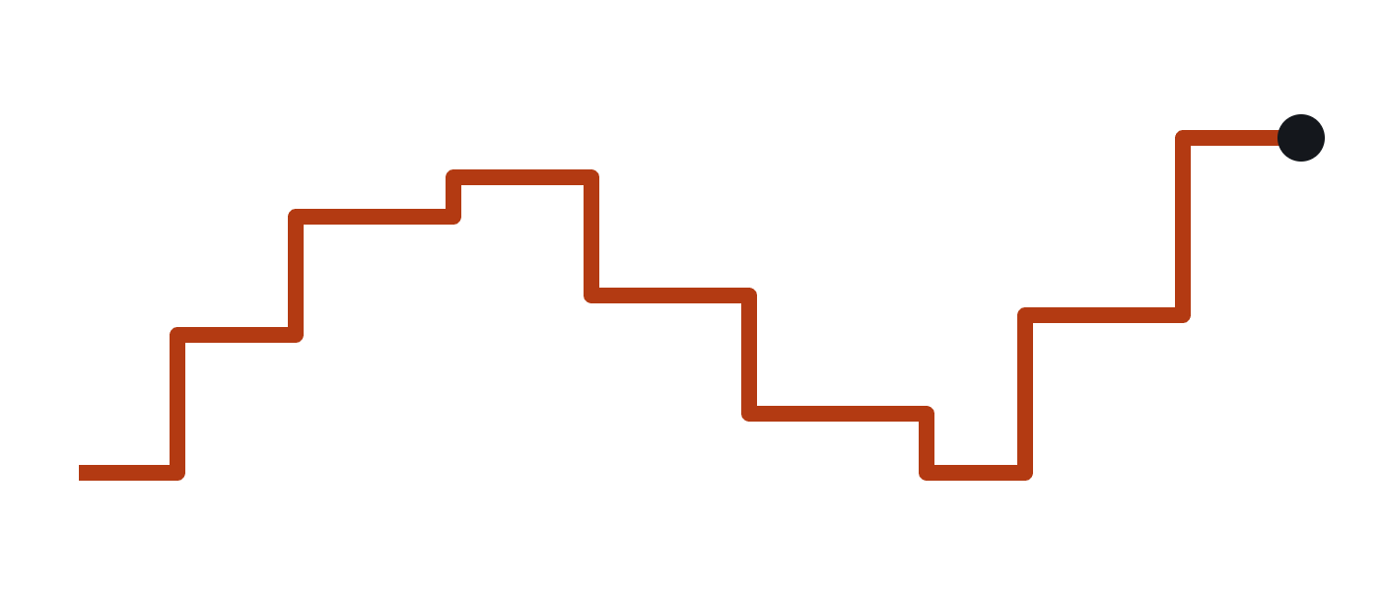
Same board. Same sensor. One line different.
CLIFFHANGER · SEE YOU TOMORROW
Version A: buttery smooth
Version B: laggy, jumpy
Bonus mystery: two tasks each add 1 to a counter a million times. The answer isn’t 2,000,000. Why?
Why does B stutter? Tomorrow, you’ll find out, and fix it.
Notes:
LIVE DEMO to end Day 1. Run the TiltMouse twice on the projector: Version A: the normal code (sensor task uses vTaskDelayUntil and has the highest priority). The cursor glides. Use Demo6_Stutter (TiltMouse plus a background job that hogs the CPU 80 ms out of every 100). Version B: change the ONE line at the top, SENSOR_PRIORITY 4 → 1, and upload again. The cursor stutters and jumps in bursts. Don’t explain. Ask the room: “Same board, same sensor, same everything except one line. Why?” Let them guess overnight. Tomorrow’s project session opens with the answer, and they’ll understand it because of today. Bonus mystery (Demo7_RaceCounter, type r + Enter a few times): two tasks on the two cores each do counter++ a million times. The result is less than 2,000,000, and different every run. That’s a race condition, the first topic of Day 2. Closing line: “Today you learned how an RTOS thinks. Tomorrow you make it talk, fight and build a mouse. See you at 2.”

